Slide 1
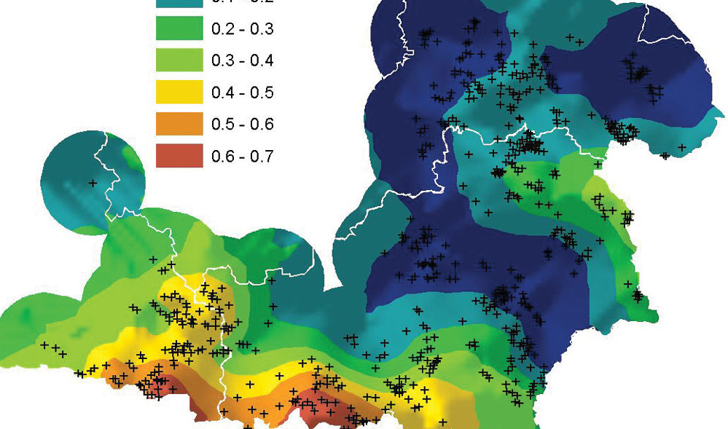

An exploratory result Estimating Barangay Poverty Incidence through Geostatistics
National Anti-Poverty Commission
Policy Monitoring and Social Technology Service (PMSTS) Unit

Slide 2
Small Area Estimates of Poverty Indicators
What we have so far are 2009 Intercensal Small Area Estimates of Poverty Indicators (poverty incidence, poverty gap, and poverty severity) produced by the NSCB from:
2009 Official Poverty Incidence
Time invariant variables from the latest Family Income and Expenditure Survey (FIES), Labor Force Survey (LFS), and Census of Population and Housing (CPH)
SAE methodology employed made use of the Elbers, Lanjouw, and Lanjouw (ELL) methodology

Slide 3
Geographic Distance and SAE
Let’s assume that the SAE already reasonably takes into account time invariant variables.
We can hypothesize that further differentiation can already be attributed to geographic distance.
As shown by PMSTS in an earlier Spatial Autoregression (SAR) Study, poverty at the municipal level is significantly spatially autocorrelated
Similar results had been produced by the 2012/13 Philippine Human Development Result (PHDR)

Slide 4
Assuming Poverty Clustering
There are various ways to test this, but the best one may be to conduct a spatial autoregression analysis on actual poverty counts.
But if we have this, no need for SAE to begin with.
We can do it through NHTS-PR, but it is not full census and may skew the results
We can do it through geomatics, but existing poverty morphologies in the Philippines are limited to urban areas (the Manila Observatory).
Approach: Assume for the moment that it is true. Besides, there are various microeconomic a priori models that predict “poverty clustering” (income sorting urban economics models)

Slide 5
Zooming in on the SAE
Assuming that poverty at an even smaller level is determined primarily by geography, we already have several tools to estimate lower levels, say, zooming in from Municipal-level SAE to Barangay level poverty estimates.
Tools from Geostatistics (Kriging, Semivariogram, Semivariance) – to be explained later
The only requirement would be to do it in reasonably contiguous areas (say, at the provincial level).

Slide 6
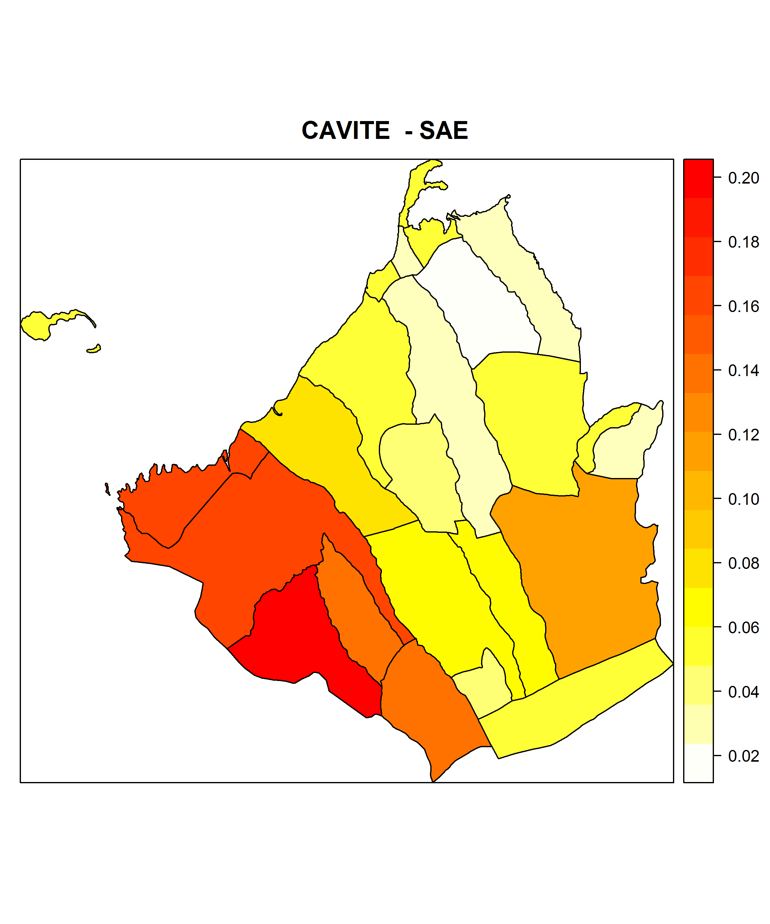
Test Case: Cavite Province

Slide 7
From Shape to Point Data
We can suppose that these municipal level estimates are taken from the centroids of the municipalities .
We can adjust it later to centroids of the most populous barangay of municipalities, or other metrics.
The problem then becomes, how does the Poverty Incidence move as we closer/away from these various points?

Slide 8
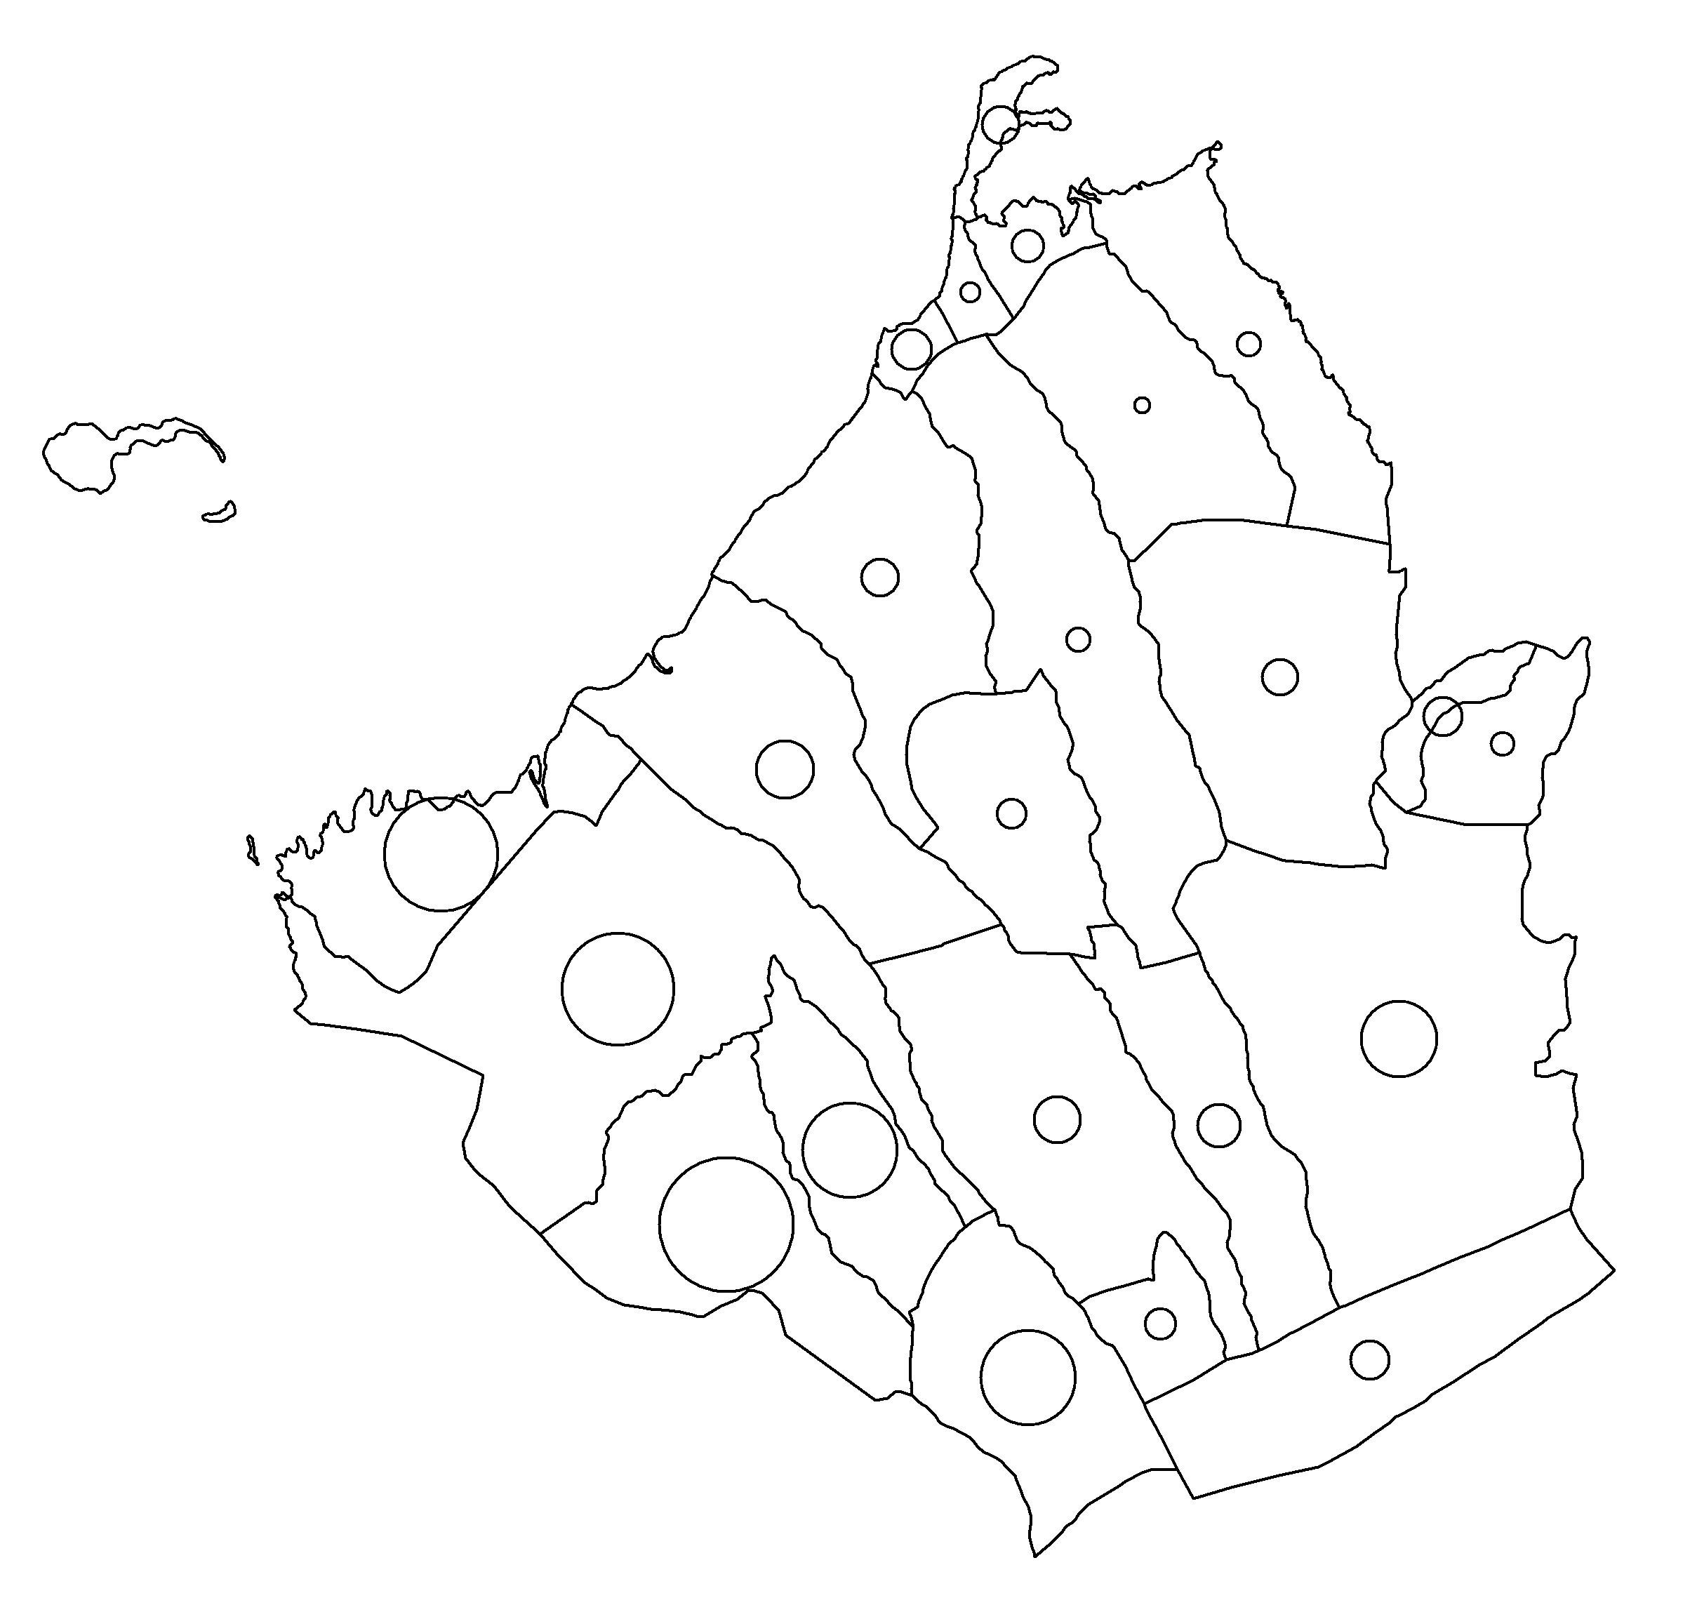
From Shape to Point Data
Question: What is the poverty incidence at the other points?
Naturally, we can assume that areas closer to the points with higher poverty incidence to have high poverty also. The similarity to the point decreases (variance increases) the farther you are from the point.
Note: Size of the Circle reflects poverty incidence

Slide 9
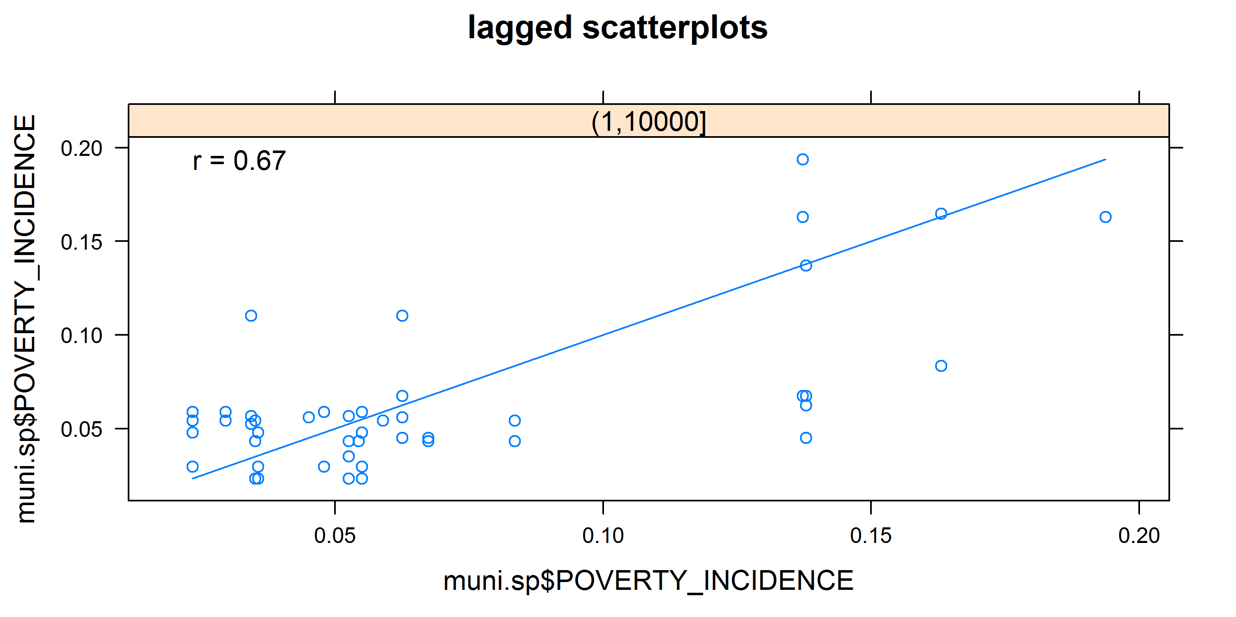
H-Scatterplot of Poverty Incidence

Slide 10
Geostatistics
The value of the rest of the points can be estimated through geostatistics.
Semivariogram Analysis and Kriging
First known applications are in the mining industry.
Semivariogram – A graph of the variance vs. the distance, shows how the variance moves as one moves away from a point.
Kriging – Fits a model curve to the semivariogram and predicts the values at the rest of the points in the map using the model curve.

Slide 11
Steps in Kriging
Compute the semi-variance and generate the semi-variogram.
Fit the experimental variogram to the selected variogram model (nugget, spherical, exponential, Gaussian, power, etc.).
Estimate Kriging weights at unknown location within some neighbourhood. To do this, one can solve the Kriging equation (simple, ordinary, kriging with a trend, etc.) to find the weights (that make the Kriging estimator UMVUE).
We will all be doing this through R [see attached R code and .RData].

Slide 12
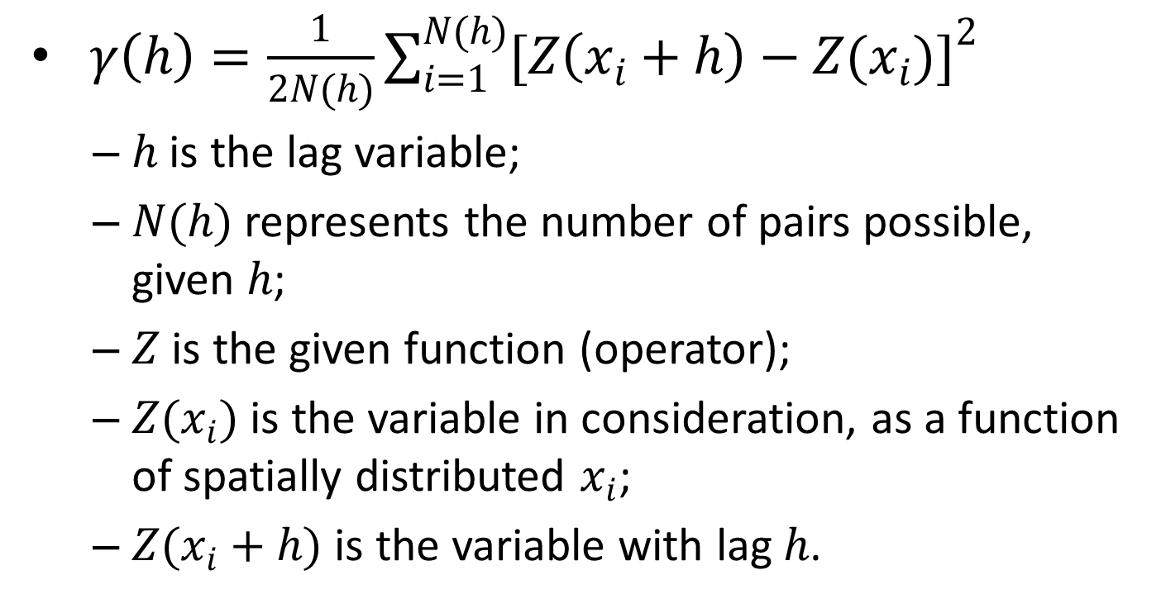
Semivariance
$γ\left(h\right)=\frac{1}{2N(h)}\sum_{i=1}^{N(h)}{{[Z\left(x_{i}+h\right)−Z(x_{i})]}^{2}}$
$h$ is the lag variable;
$N(h)$ represents the number of pairs possible, given $h$;
$Z$ is the given function (operator);
$Z(x_{i})$ is the variable in consideration, as a function of spatially distributed $x_{i}$;
$Z(x_{i}+h)$ is the variable with lag $h$.

Slide 13
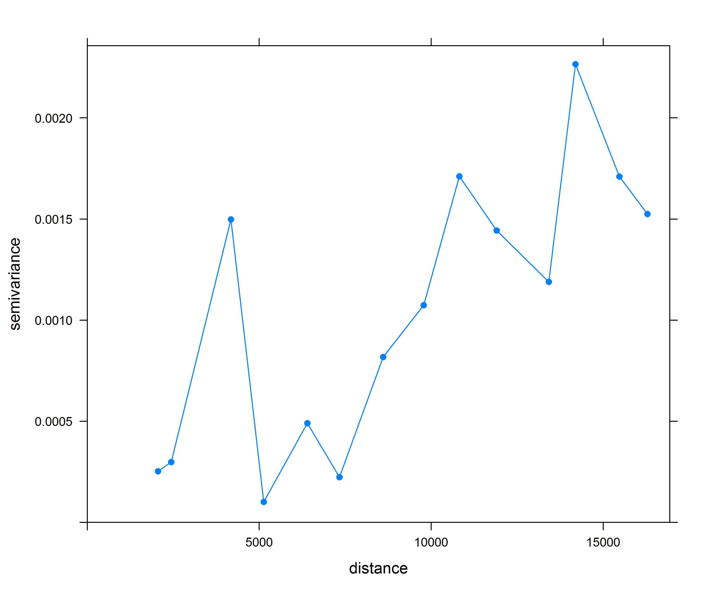
Semivariogram (Poverty Incidence)

Slide 14
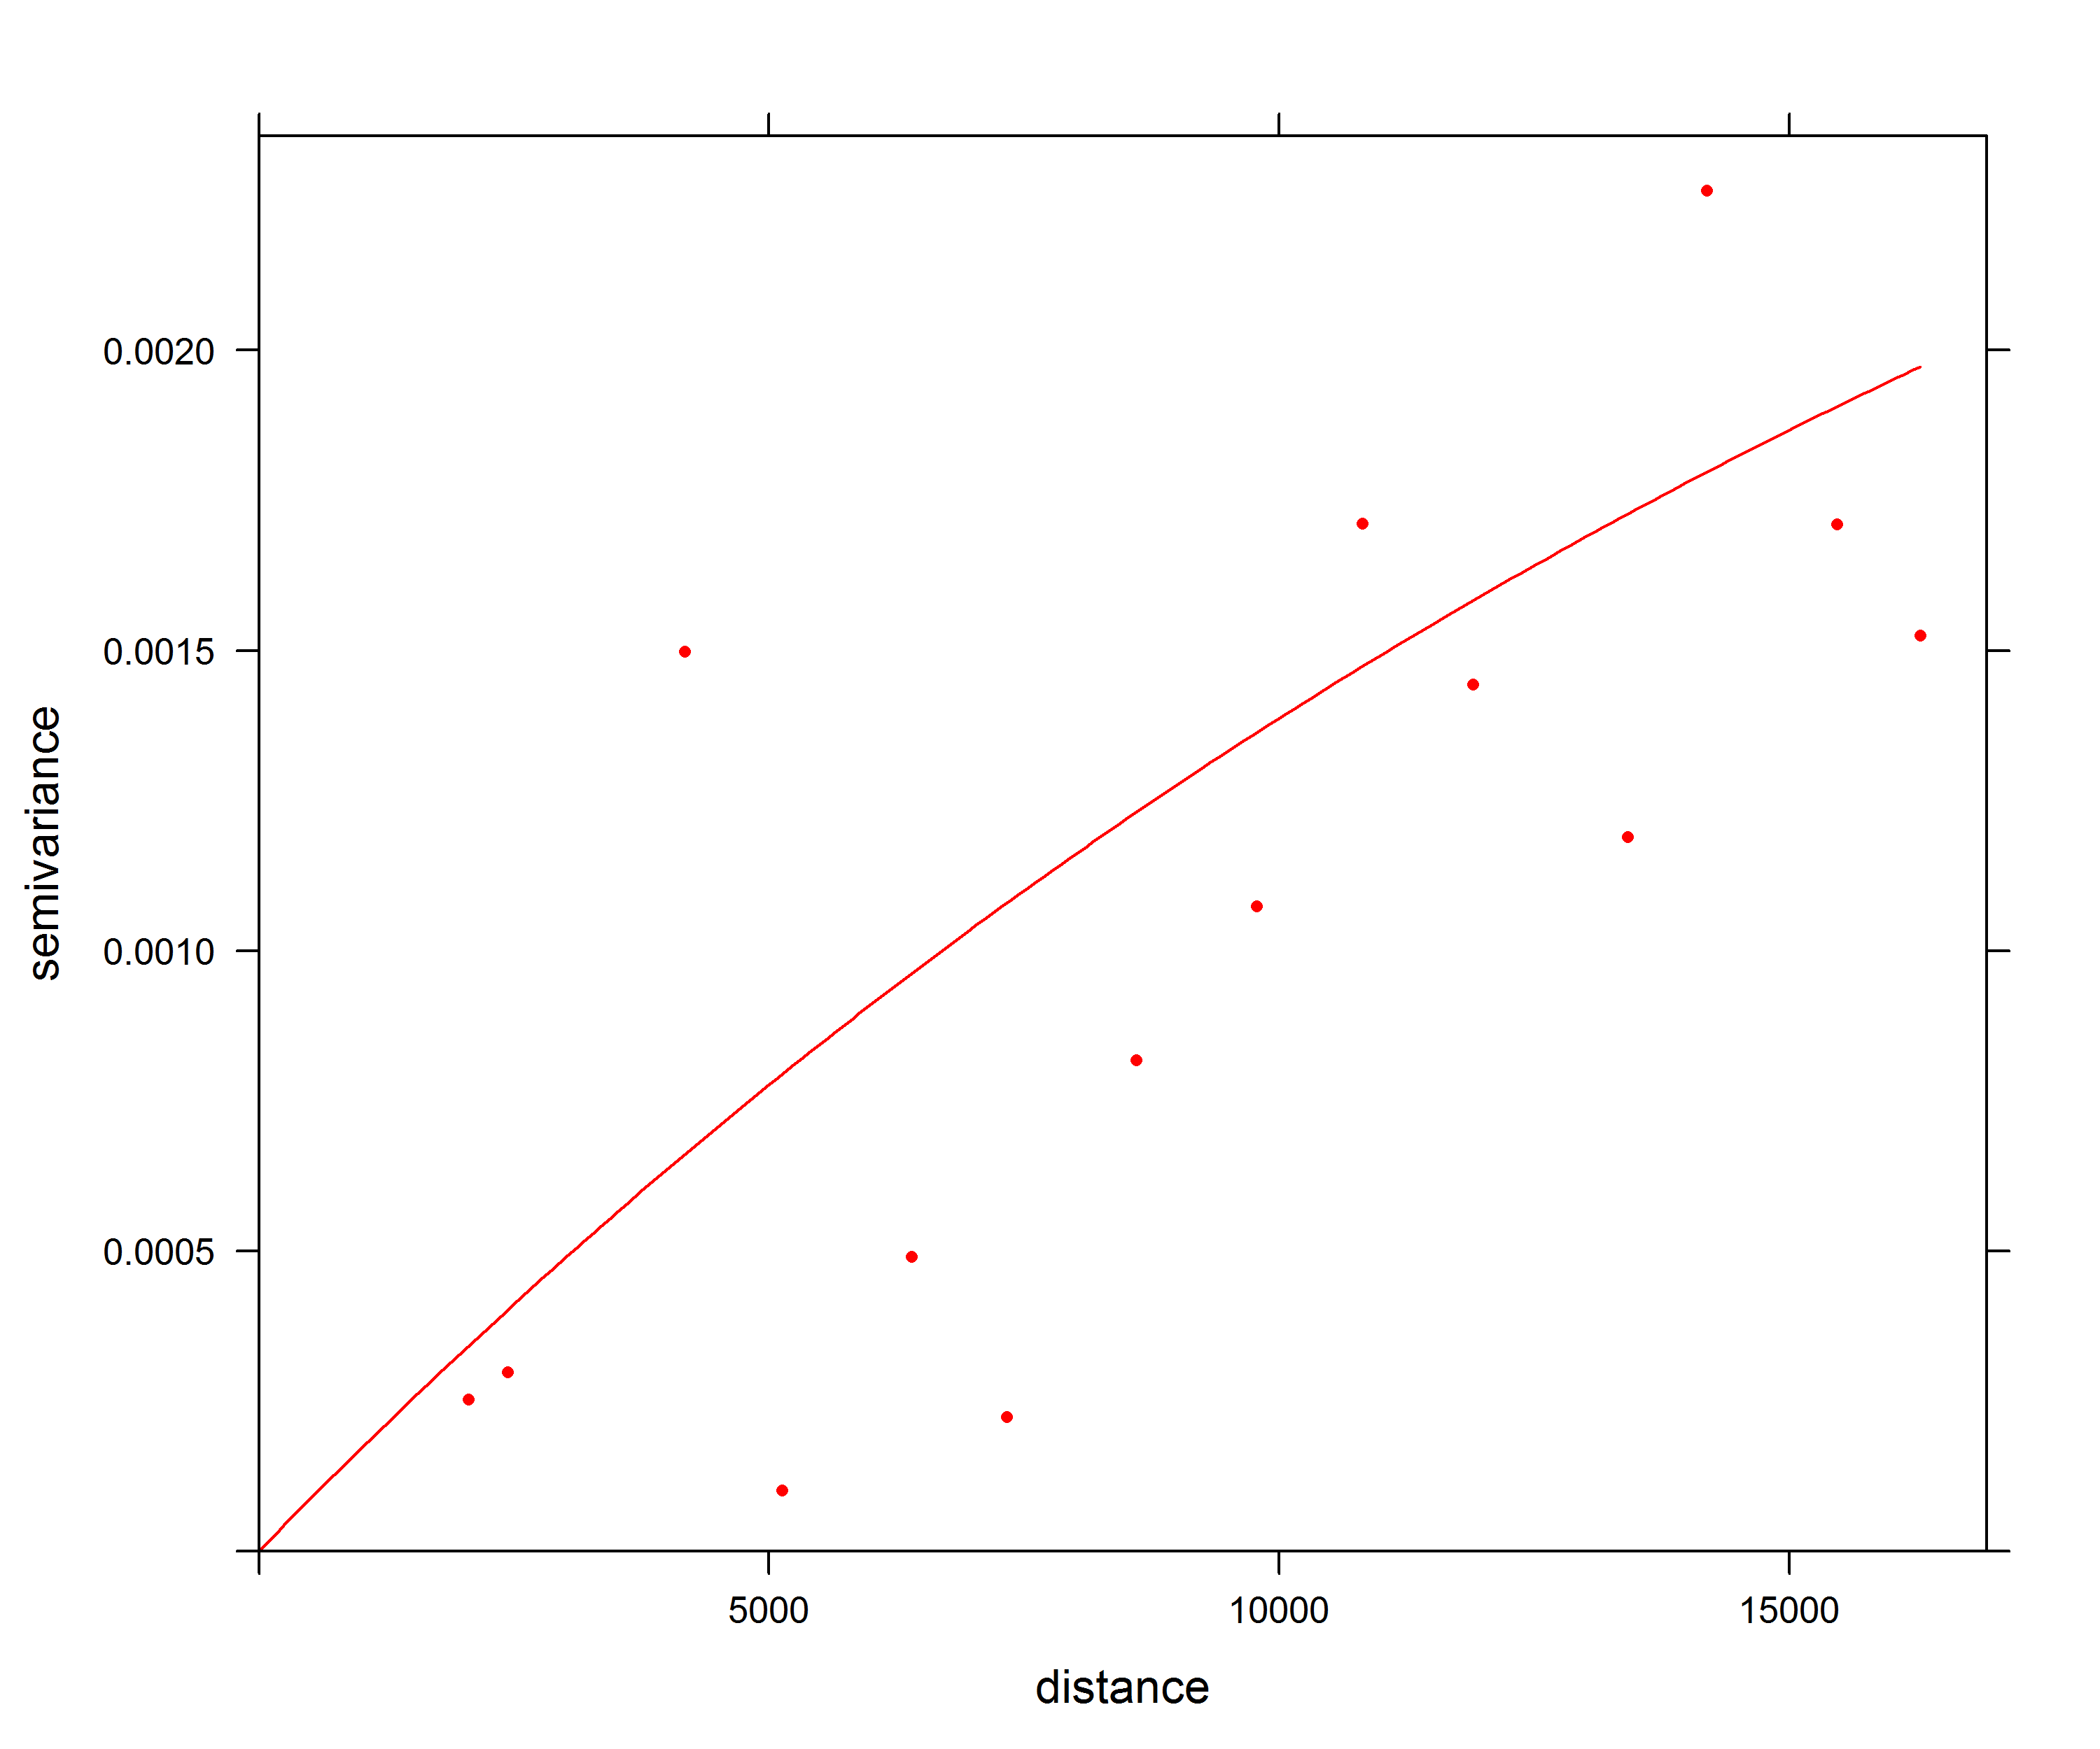
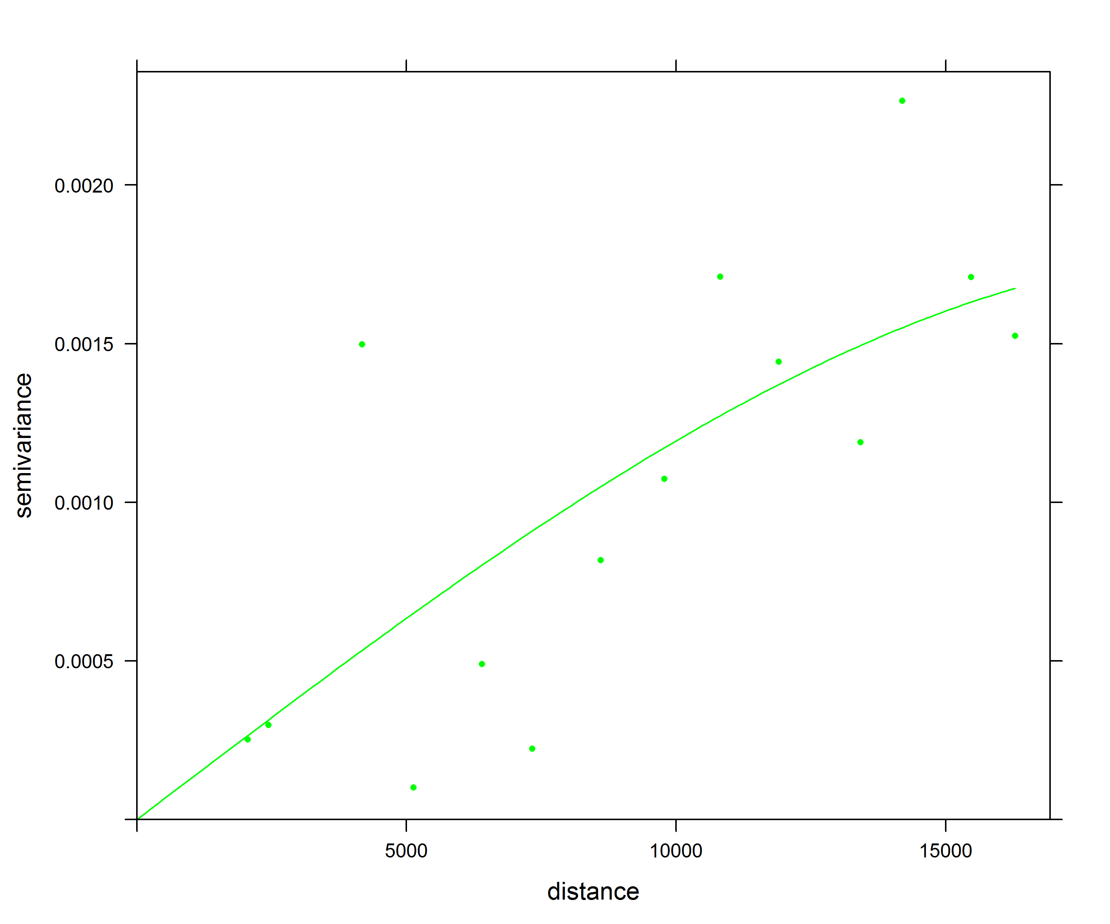
Semivariogram – Exponential (Red) vs. Spherical (Green) Fit

Slide 15
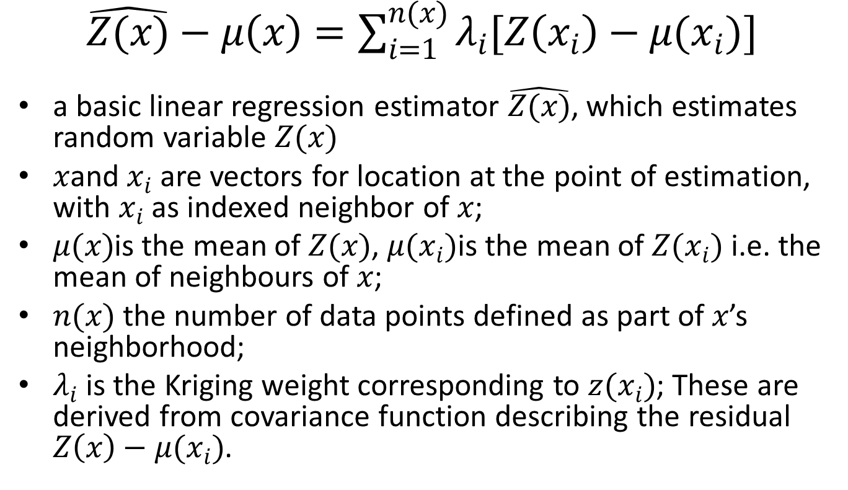
Kriging Estimator
$\hat{Z(x)}−μ\left(x\right)=\sum_{i=1}^{n(x)}{λ_{i}[Z\left(x_{i}\right)−μ(x_{i})]}$
a basic linear regression estimator $\hat{Z(x)}$, which estimates random variable $Z(x)$
$x$and $x_{i}$ are vectors for location at the point of estimation, with $x_{i}$ as indexed neighbor of $x$;
$μ(x)$is the mean of $Z(x)$, $μ(x_{i})$is the mean of $Z(x_{i})$ i.e. the mean of neighbours of $x$;
$n(x)$ the number of data points defined as part of $x$’s neighborhood;
$λ_{i}$is the Kriging weight corresponding to $z(x_{i})$; These are derived from covariance function describing the residual $Z\left(x\right)−μ(x_{i})$.

Slide 16
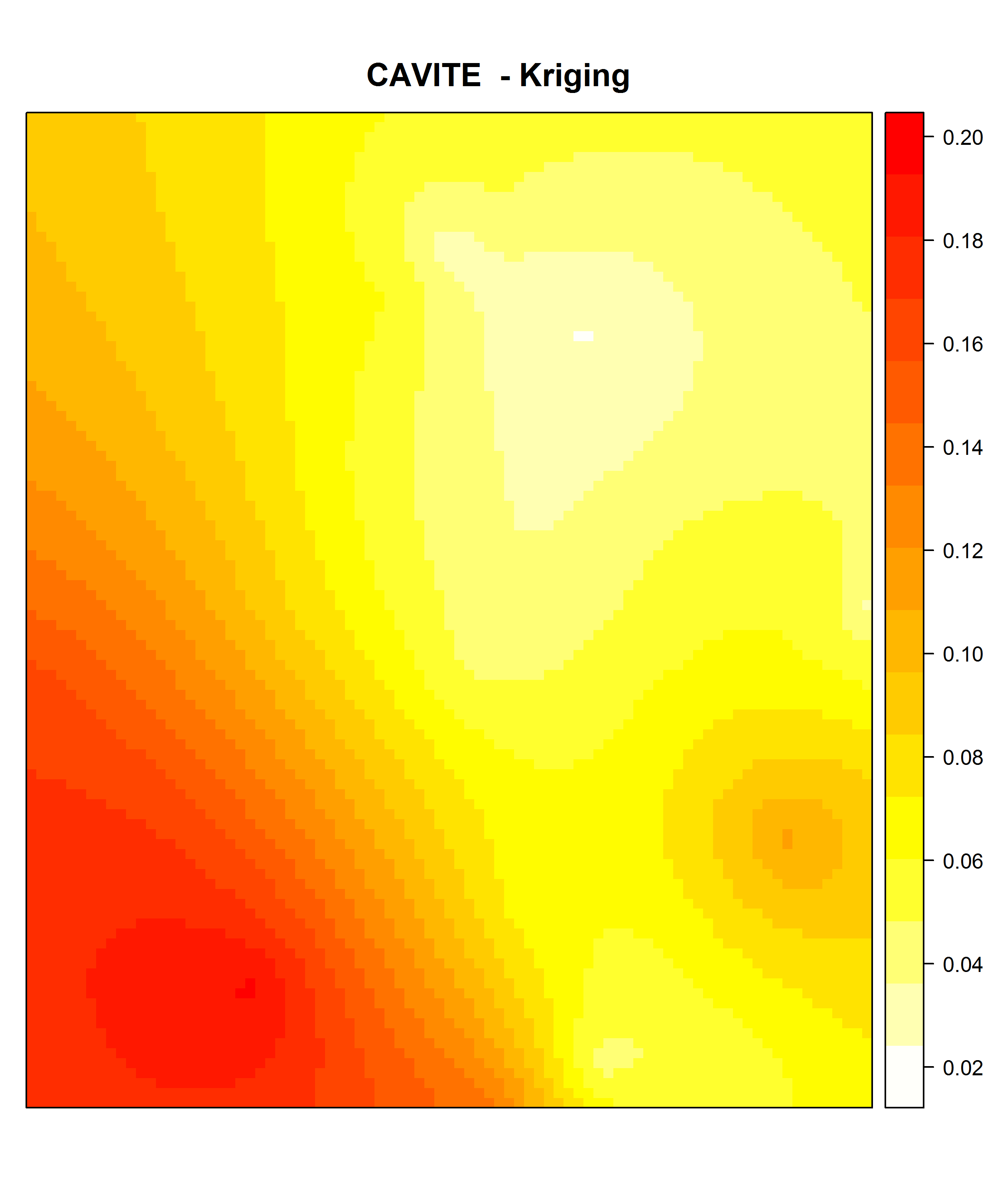
Heat Map from the Kriging Estimator
Note that the model accurately predicted two “peaks” of poverty.

Slide 17
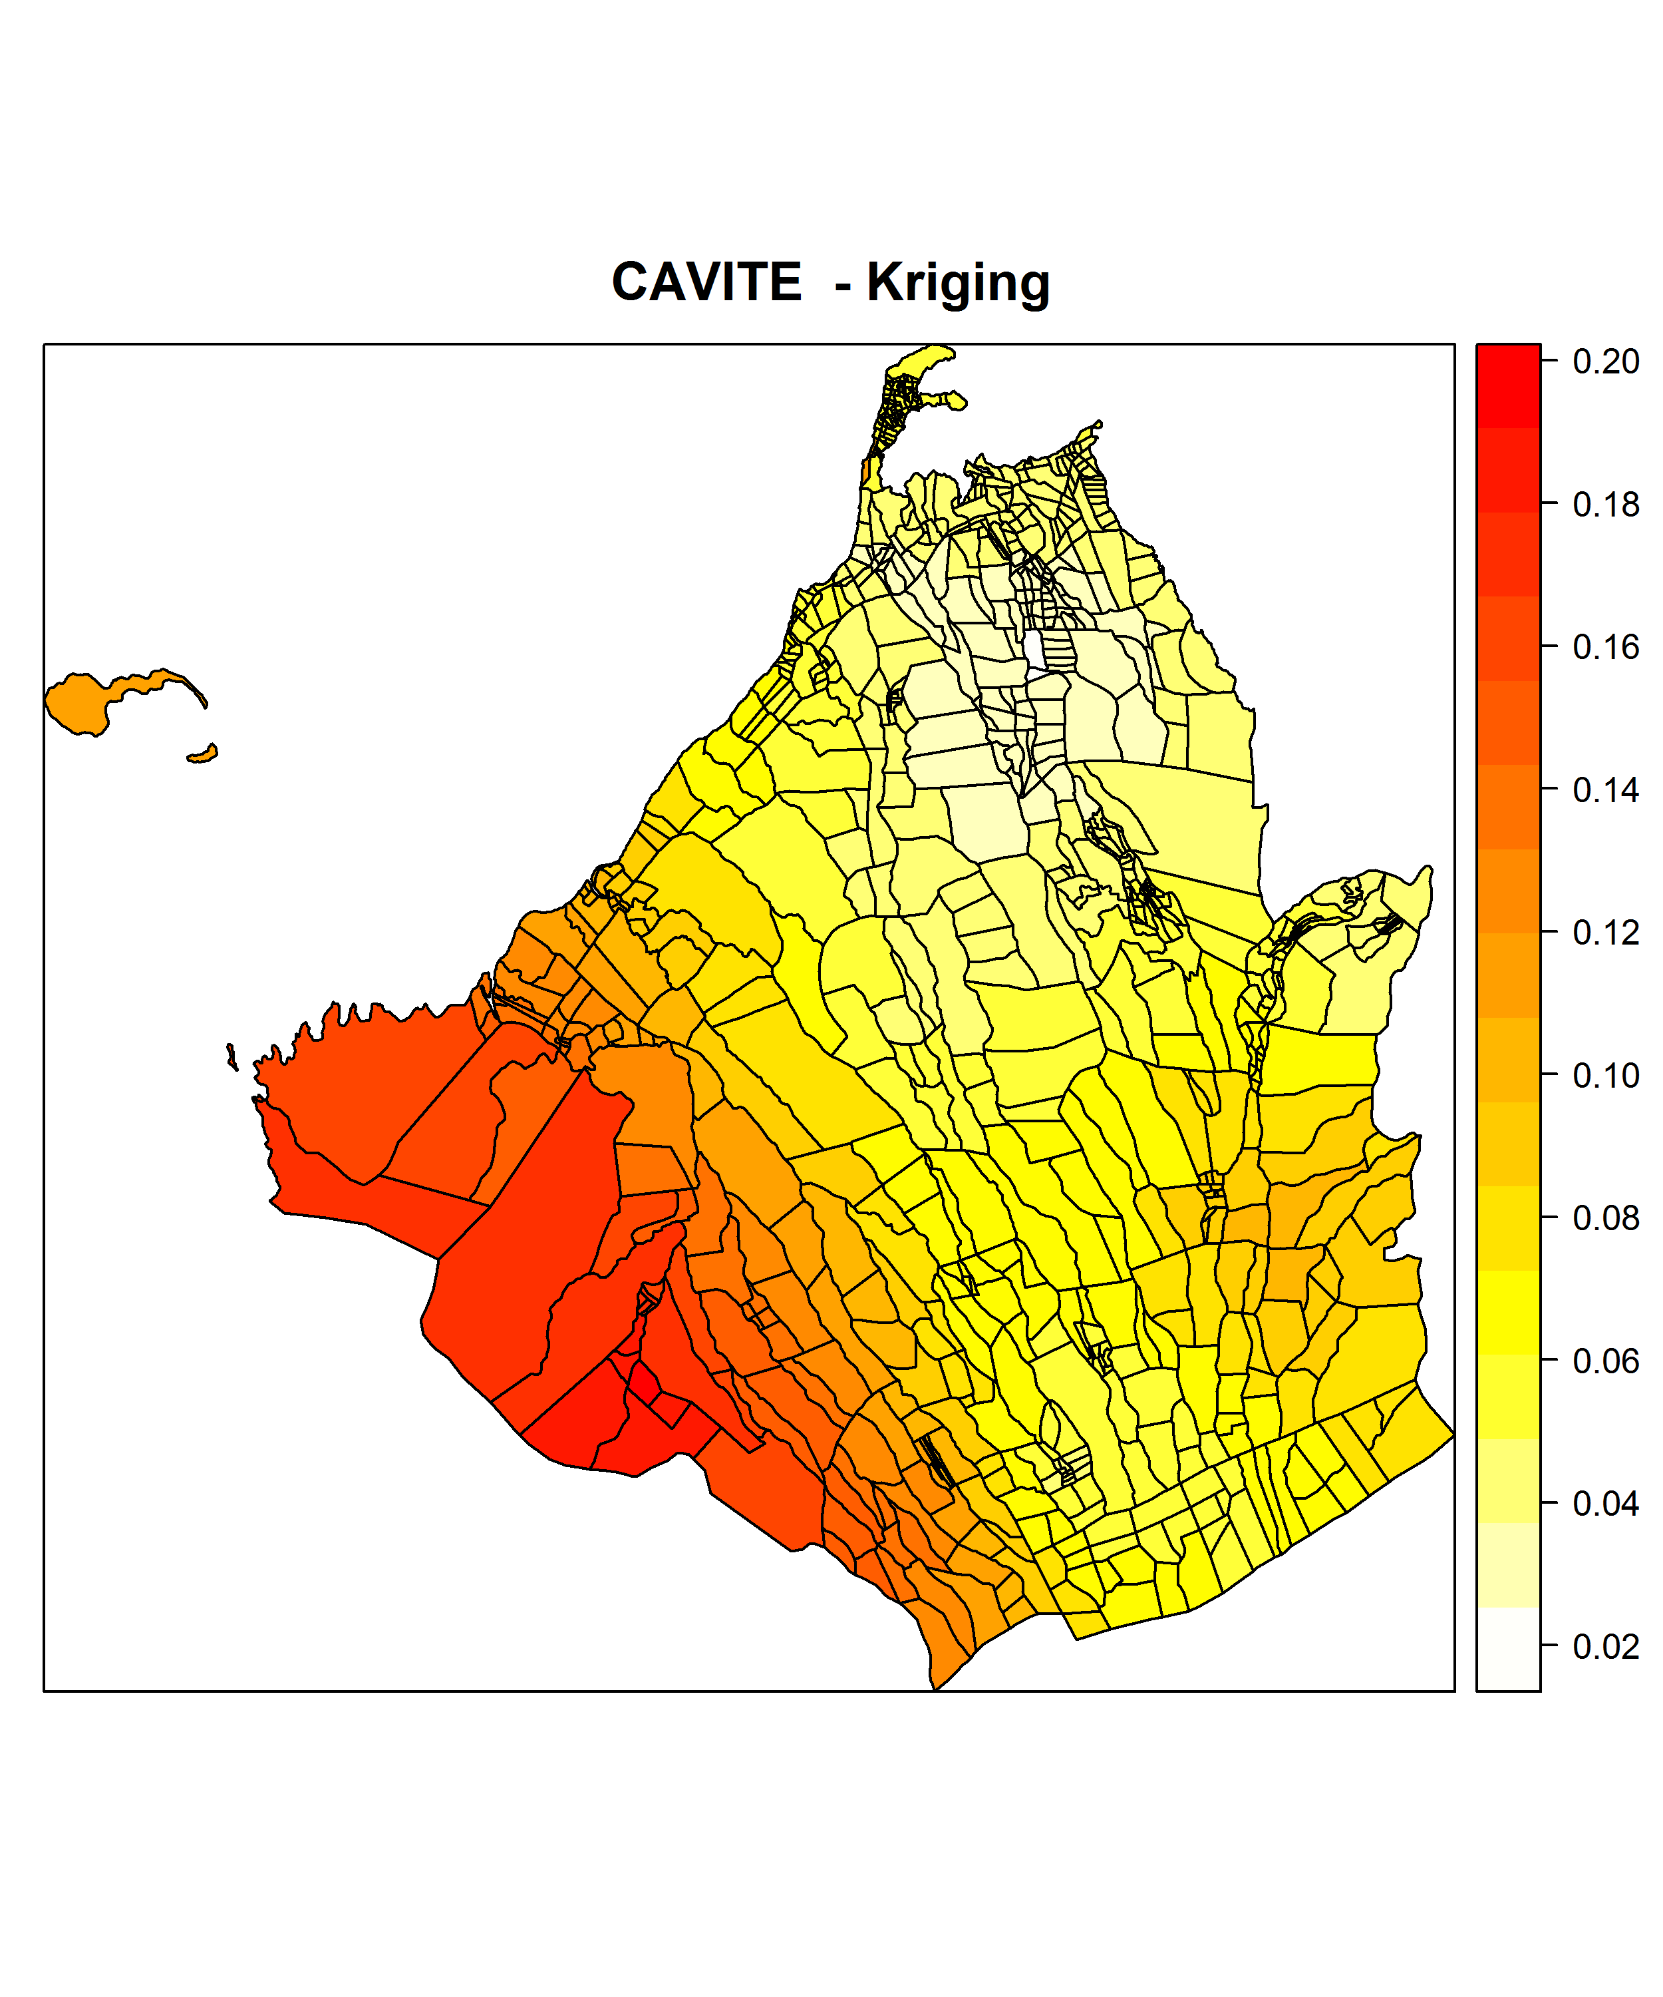
Polygon/Zonal Statisics Map for Cavite
It is no longer necessary that Barangays within a municipality has the same poverty incidence.
See attached document (in .xlsx) for the actual predicted poverty incidence.

Slide 18
Comparing the Kriged Estimates (Barangay) and the SAE (Municipality)
Note that there are now gradations within municipalities. Colors of barangays depend on the poverty incidence not just of its own municipalities but also neighboring ones.

Slide 19
Next Steps
Use a different centroid (most populous barangay, or barangay with highest household poverty incidence in a municipality [from NHTS-PR, if available])
Co-Kriging with other municipal-level variables which are known determinants of poverty – population (mostly from NHTS also)

